Slide 1
Weekly Poor PDP Case Review
Aug 17 - Aug 30, 2026

Slide 2
Weekly Poor PDP Case Review
Overview | Aug 17 - Aug 30, 2026
Metric | Value
Total Poor Case in last 2 weeks | 73
Total Types of Product | 14
Total Case related to Log Team (%) | 59 (80.8%)
Total Case not related to Log Team (%) | 14 (19.2%)

Slide 3
Weekly Poor PDP Case Review
Problems Pattern | Aug 17 - Aug 30, 2026
Problem | Cases | Products | %
包裝問題 | 30 | 10 | 50.8%
其他 | 18 | 8 | 30.5%
溫度問題 | 5 | 1 | 8.5%
原箱問題 | 4 | 2 | 6.8%
少貨問題 | 1 | 1 | 1.7%
罐裝問題 | 1 | 1 | 1.7%

Slide 4
Weekly Poor PDP Case Review
Comparison of Performance by Districts | Aug 17 - Aug 30, 2026
Rank | District | Cases | Rep. Product (ID + Name) | % of Log Team
1 | ETX | 18 | H0888001_S_10160087 | 【原箱】雪花啤酒 (330毫升 x24) | 30.5%
2 | ETK | 14 | H0888001_S_P10020854 | [原箱] 屈臣氏蒸餾水 800ml X 24 (新舊包裝隨機... | 23.7%
3 | WTK | 6 | H0888001_S_P10020854 | [原箱] 屈臣氏蒸餾水 800ml X 24 (新舊包裝隨機... | 10.2%
4 | WTX | 5 | H0888001_S_P10020854 | [原箱] 屈臣氏蒸餾水 800ml X 24 (新舊包裝隨機... | 8.5%
5 | ETH | 4 | H0888001_S_10007711 | 檸檬茶 250ml x 9包裝 (新舊包裝隨機發送) | 6.8%
6 | NT-ST | 4 | H0888001_S_10021201A | 可口可樂無糖汽水 x2 #zero #coke zero (... | 6.8%
7 | WTH | 4 | H0888001_S_P10020854 | [原箱] 屈臣氏蒸餾水 800ml X 24 (新舊包裝隨機... | 6.8%
8 | NT-TW | 3 | H0888001_S_10162231 | [法國直送] 全脂牛奶(1公升)#Halal清真#3.6 | 5.1%
9 | NT-TM | 1 | H0888001_S_10020138A | [官方供應] 亨氏清雞湯 #上等嫩雞 #不含人造色素和防腐劑 | 1.7%
Total Log Team Cases: 59 | Sum%: 100.1%

Slide 5
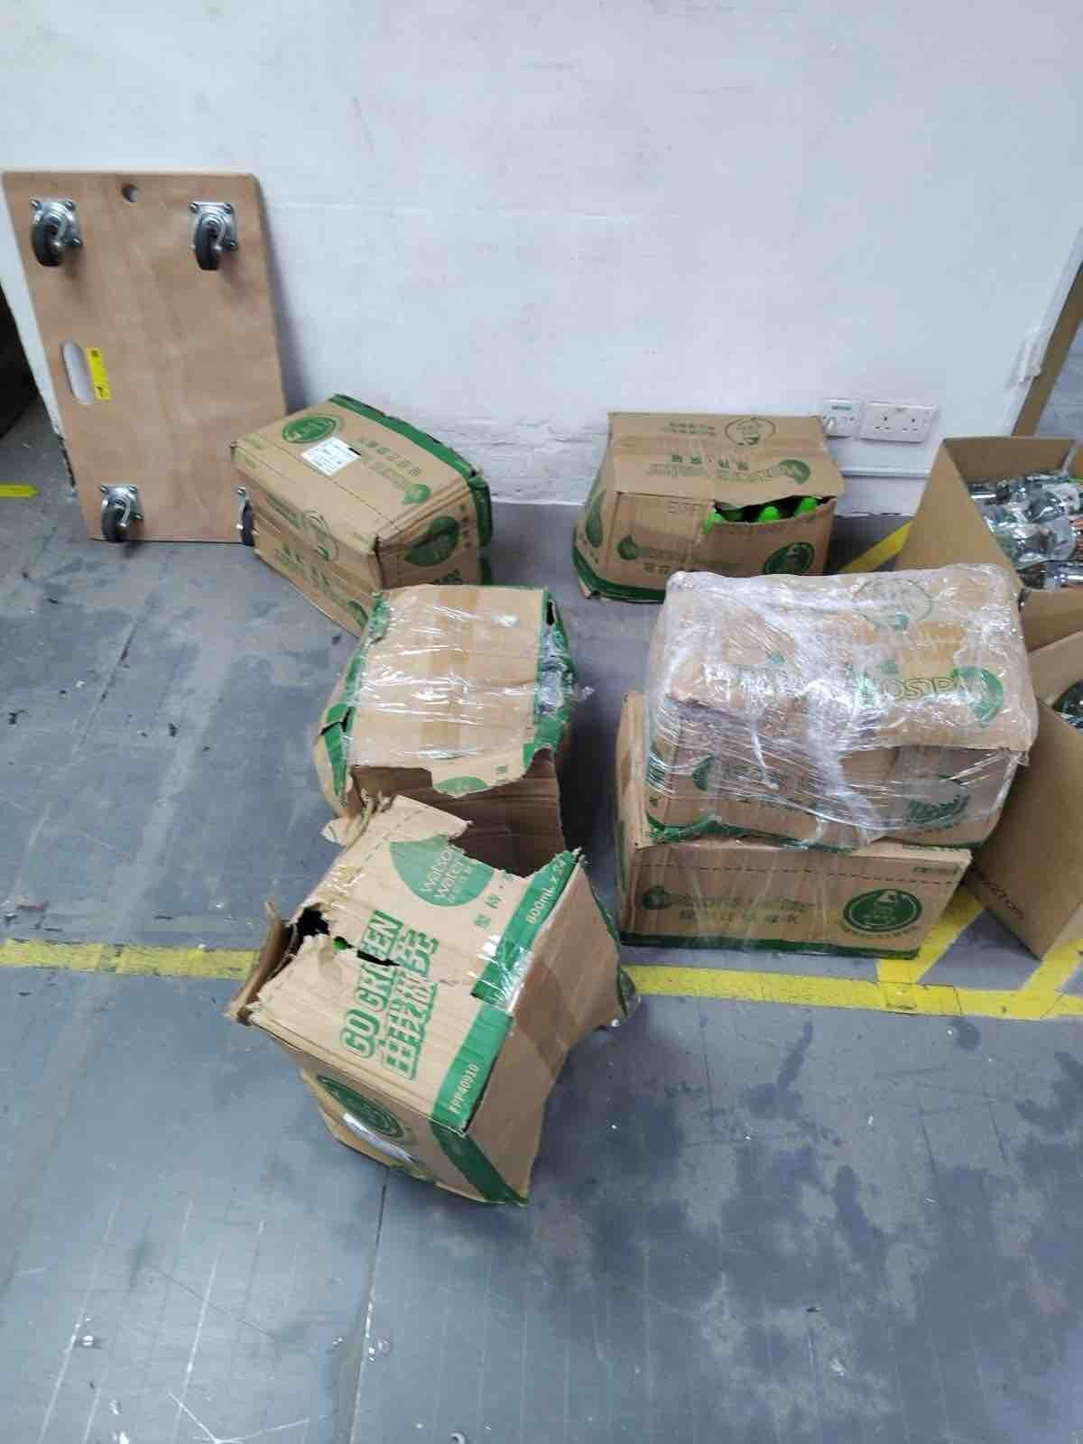
Weekly Poor PDP Case Review
Case Review - 包裝問題 (30 cases in window)
Product ID: H0888001_S_P10020854 | [原箱] 屈臣氏蒸餾水 800ml X 24 (新舊包裝隨機發送)
District: ETK
Shipping Warehouse: 將軍澳倉
Pickpack Warehouse: Warehouse貨
Order: H260823507486 | Waybill: 8141807103-1
Checking Result: 外包裝用再做紙做成, 比普通紙箱更容易破爛
Customer Comment:
9箱基本上全部外箱都爛
1/2

Slide 6
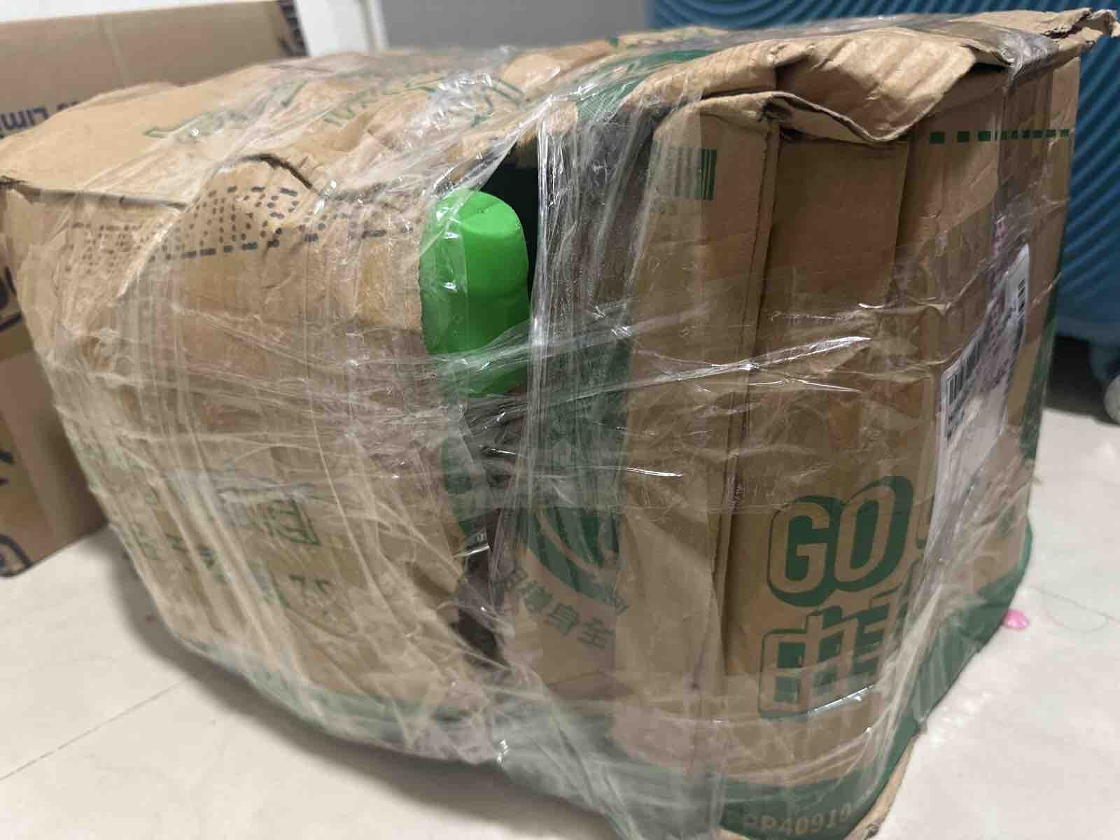
Weekly Poor PDP Case Review
Case Review - 包裝問題 (30 cases in window)
Product ID: H0888001_S_P10020854 | [原箱] 屈臣氏蒸餾水 800ml X 24 (新舊包裝隨機發送)
District: ETK
Shipping Warehouse: 將軍澳倉
Pickpack Warehouse: Warehouse貨
Order: H260824517442 | Waybill: 8144901680-1
Checking Result: 外包裝用再做紙做成, 比普通紙箱更容易破爛
Customer Comment:
專登上官方旗艦店訂購，點解包裝都可以爛成咁😥😥
2/2

Slide 7
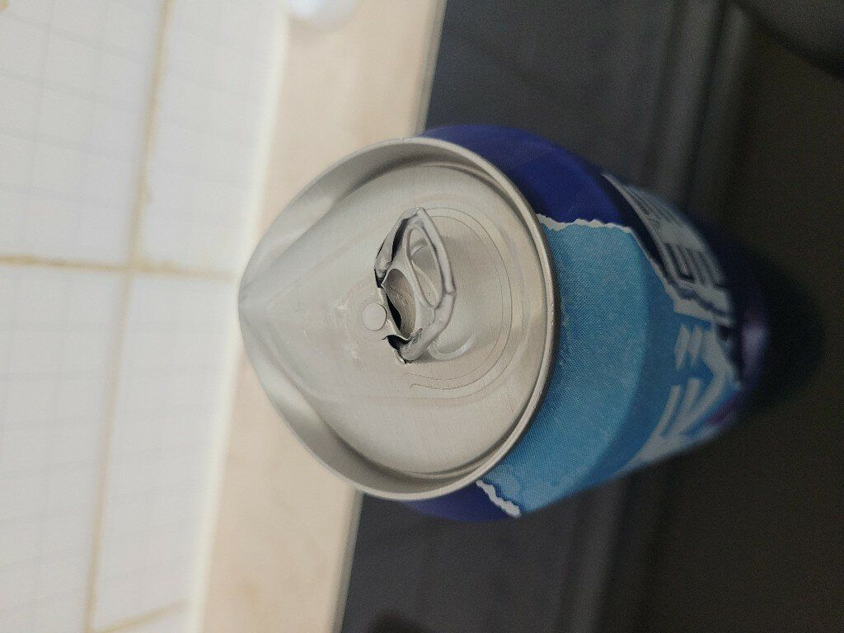
Weekly Poor PDP Case Review
Case Review - 其他 (18 cases in window)
Product ID: H0888001_S_10160087 | 【原箱】雪花啤酒 (330毫升 x24)
District: ETX
Shipping Warehouse: 青衣倉
Pickpack Warehouse: Warehouse貨
Order: H260724512104 | Waybill: 8085522674-1
Checking Result: 倉儲溫度問題
Customer Comment:
啲啤酒跌到開唔到其實係咩玩法？
考驗智慧？

Slide 8
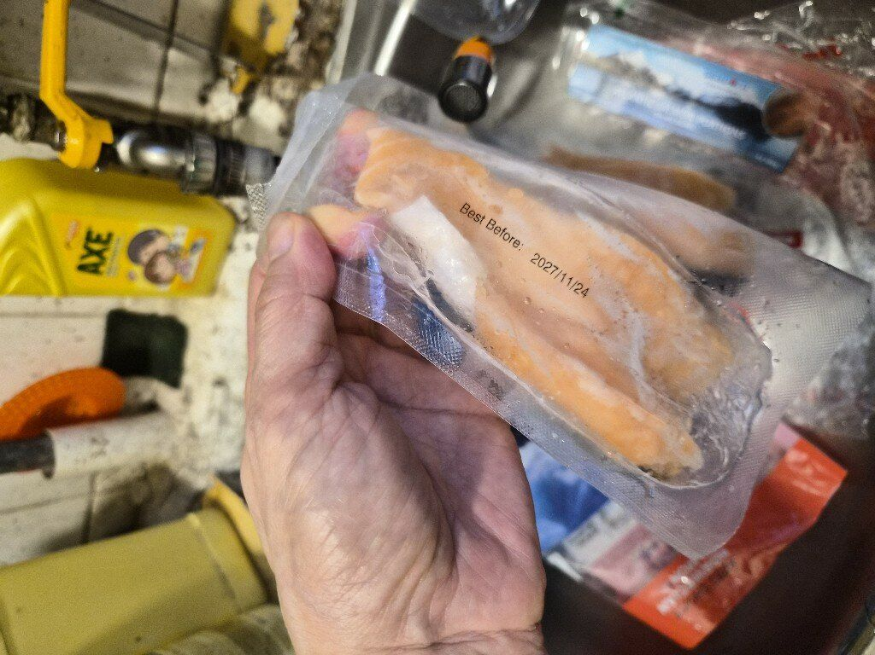
Weekly Poor PDP Case Review
Case Review - 溫度問題 (5 cases in window)
Product ID: H0888001_S_10144447 | 挪威帶皮三文魚柳(急凍-18°C)
District: NT-ST
Shipping Warehouse: 屯門倉
Pickpack Warehouse: Warehouse貨
Order: H260715543520 | Waybill: 8070888370-1
Checking Result: 品質問題, 車輀凍櫃溫度正常
Customer Comment:
的三文魚好以溶咗雪咁冇真空兼拿埋一舊
1/2

Slide 9
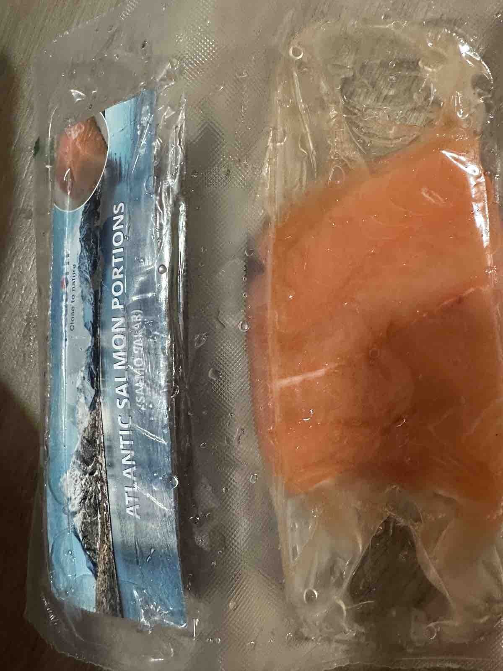
Weekly Poor PDP Case Review
Case Review - 溫度問題 (5 cases in window)
Product ID: H0888001_S_10144447 | 挪威帶皮三文魚柳(急凍-18°C)
District: NT-TW
Shipping Warehouse: 青衣倉
Pickpack Warehouse: Warehouse貨
Order: H260829535095 | Waybill: 8153618518-1
冷藏平均: 4.6 | 急凍平均: 12.5 | 冷藏最低: 7.2 | 急凍最低: 12.5
Customer Comment:
送到嚟都溶晒雪嘅，咁仲食唔食好啊？
2/2

Slide 10
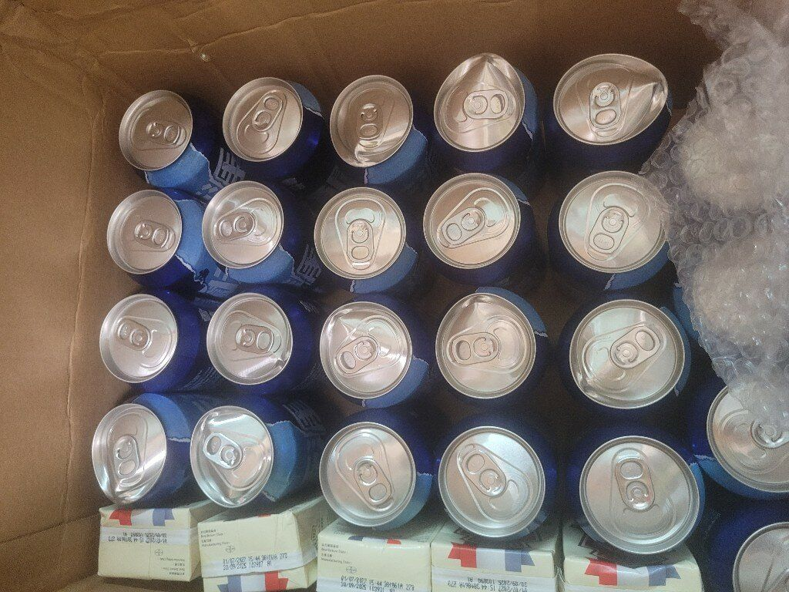
Weekly Poor PDP Case Review
Case Review - 原箱問題 (4 cases in window)
Product ID: H0888001_S_10160087 | 【原箱】雪花啤酒 (330毫升 x24)
District: ETX
Shipping Warehouse: 青衣倉
Pickpack Warehouse: Warehouse貨
Order: H260814511841 | Waybill: 8124355075-1
Checking Result: 倉儲溫度問題
Customer Comment:
我買原箱啤酒 其中一個原因就係方便存放 唔係啲啤酒散收收咁
但收貨就本身個盒已經爛左 啲啤酒就跌過哂落地 漲哂 就黎爆開咁 企都企唔穩 你要人地飲既時候全程用手揸住？
包裝穩妥其實係好簡單好基本既要求
如果做唔到 麻煩係商品描述度 備註清楚“原裝包裝質量成疑 可以未送貨先損壞 啤酒有機會破損 請有心理準備”

Slide 11
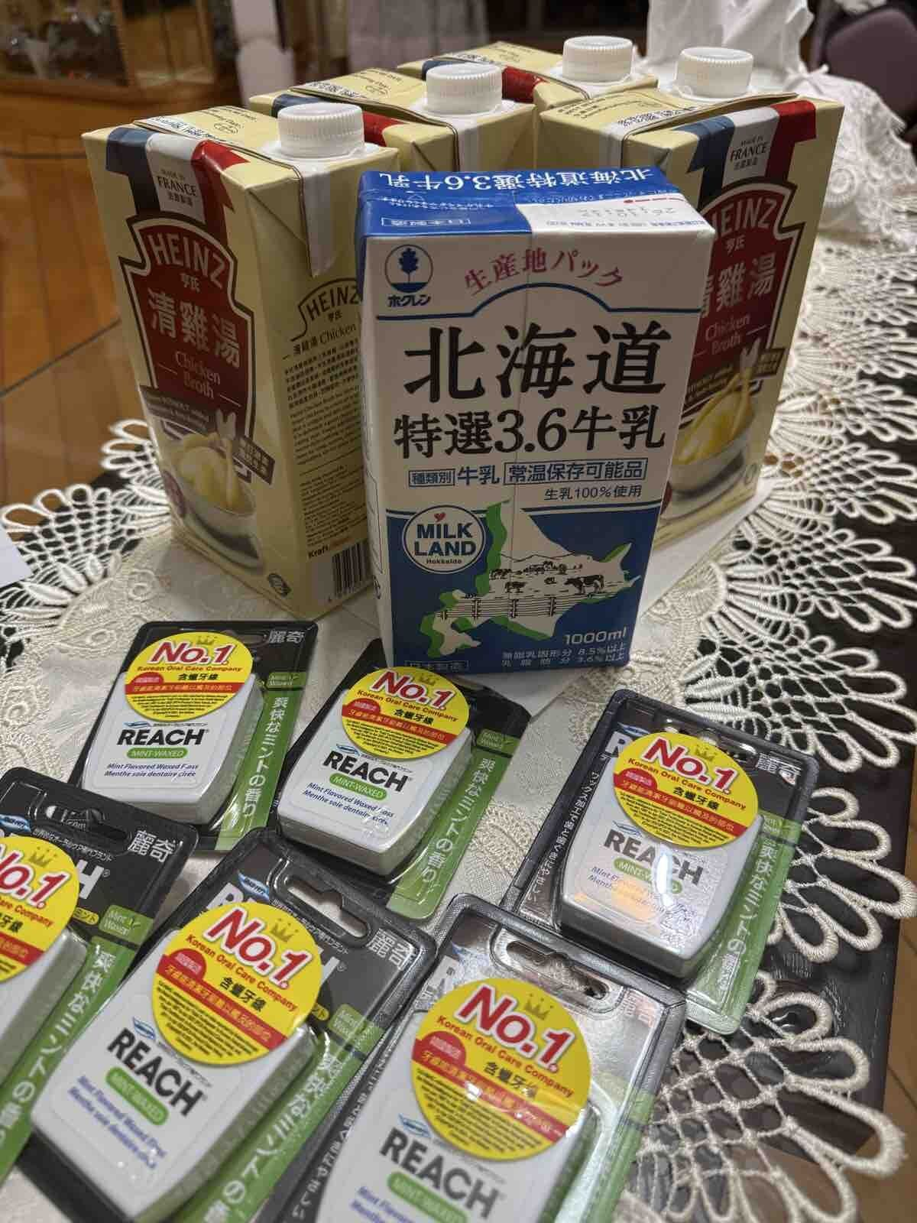
Weekly Poor PDP Case Review
Case Review - 少貨問題 (1 cases in window)
Product ID: H0888001_S_10010656A | 北海道特選3.6牛乳 1公升 X 2
District: WTK
Shipping Warehouse: 青衣倉
Pickpack Warehouse: Warehouse貨
Order: H260817501056 | Waybill: 8131044818-1
Customer Comment:
牛奶買咗兩盒，只係送一盒，雞湯買咗六盒，只係送四盒，一時冇留意，提交申請退款時只係填咗牛奶，冇填到雞湯，請問而家可以點樣申請退款？有冇搞錯？每樣嘢都送漏啲？

Slide 12
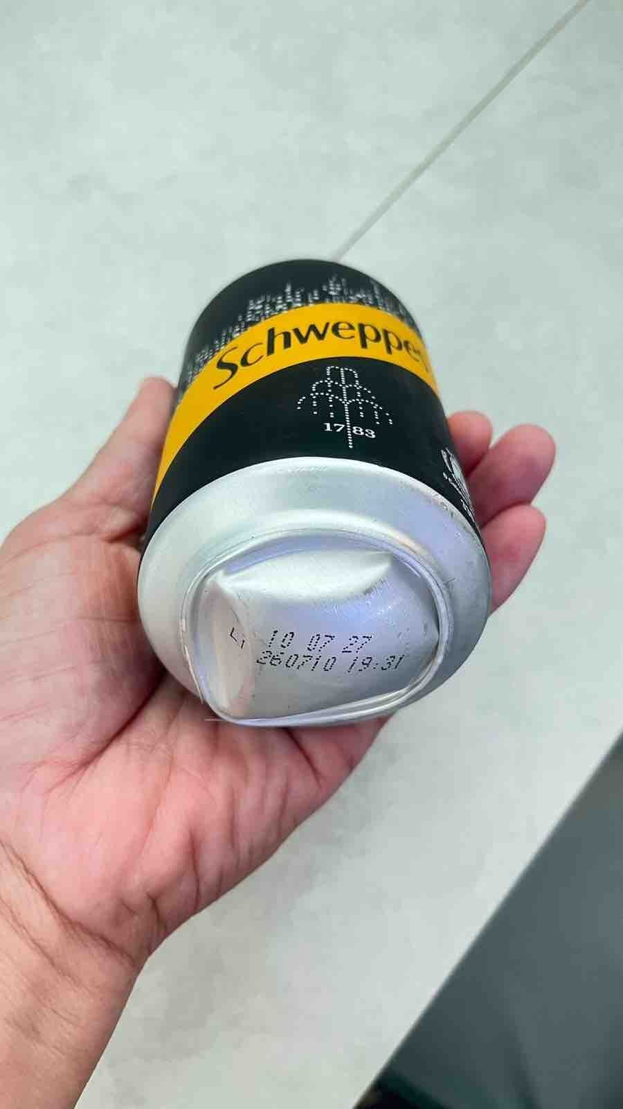
Weekly Poor PDP Case Review
Case Review - 罐裝問題 (1 cases in window)
Product ID: H0888001_S_10136268A | 玉泉梳打水330ml x 8罐裝 x 2 (新舊包裝隨機發送)
District: WTK
Shipping Warehouse: 青衣倉
Pickpack Warehouse: Warehouse貨
Order: H260819507945 | Waybill: 8134096967-1
Customer Comment:
有2set，其中8罐冇事，另外1set，一半都是罐底凸起！

